Slide 1
Nykaa Product & Beauty Performance Analysis
Turning product data into actionable business insights

Slide 2
INTRODUCTION
GOAL: To uncover key trends in product performance, stock levels, and customer engagement that can support Nykaa’s business growth and competitive positioning.

Slide 3
DATA OVERVIEW
Data Source: Kaggle
Total Products Analyzed: 3663
Unique Brands: 25
Key Attributes: Brand, Product Title, MRP, Price, Rating,Rating Count, In-stock

Slide 4
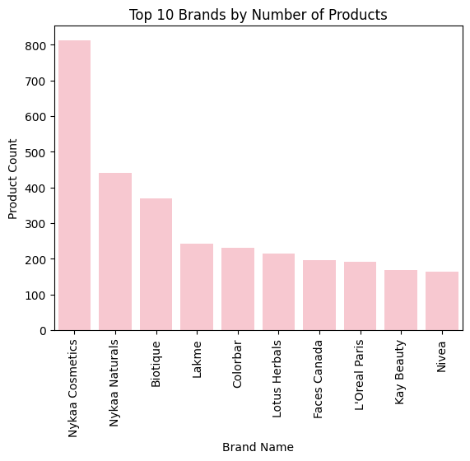
BRAND PERFORMANCE
Which brands dominate Nykaa’s marketplace?
Nykaa Cosmetics is the clear market leader, offering over 800 products, significantly outpacing the second-place brand, Nykaa Naturals, by nearly double.
The top three brands (Nykaa Cosmetics, Nykaa Naturals, and Biotique) dominate the product count, each offering well over 350 items.
A steep drop in product count occurs after the top three, with brands like Lakme, Colorbar, and Nivea representing the significantly smaller volume of the remaining list.

Slide 5
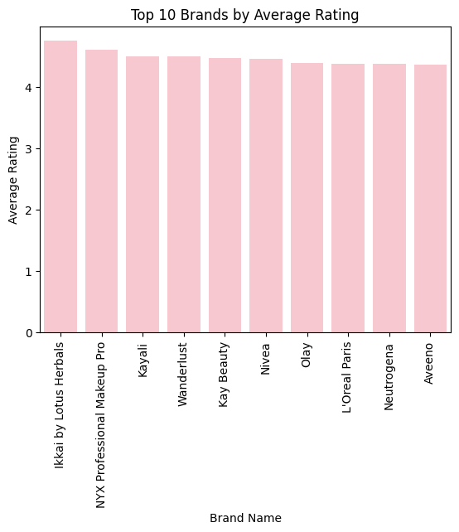
BRAND PERFORMANCE
Which Brands Do Customers Trust the Most?
Ikkaiby Lotus Herbals holds the top spot for average rating, narrowly leading the pack with a rating just under 4.5.
Ratings are highly competitive across the top 10 brands, with all brands, from NYX Professional Makeup Pro down to Aveeno, achieving an average rating of approximately 4.2 or higher.
The difference between the highest and lowest-rated brands in the top 10 is minimal, suggesting that customers perceive high quality across this entire group.

Slide 6
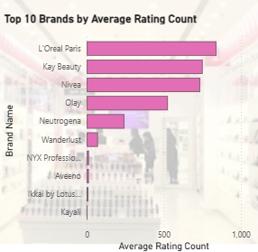
CUSTOMER ENGAGEMENT
Which brands drive the most interaction?
L'Oreal Paris overwhelmingly leads in customer engagement, receiving over 800 average ratings nearly double that of the next two brands combined.
Kay Beauty and Nivea form a competitive second tier, each consistently gathering over 700 average ratings.
Rating volume is highly concentrated in the top five brands. The remaining five brands (Wanderlust, NYX Professional Makeup Pro, Aveeno, Ikkai by Lotus Herbals, and Kayali) register significantly lower rating counts, despite having competitive high average ratings.

Slide 7
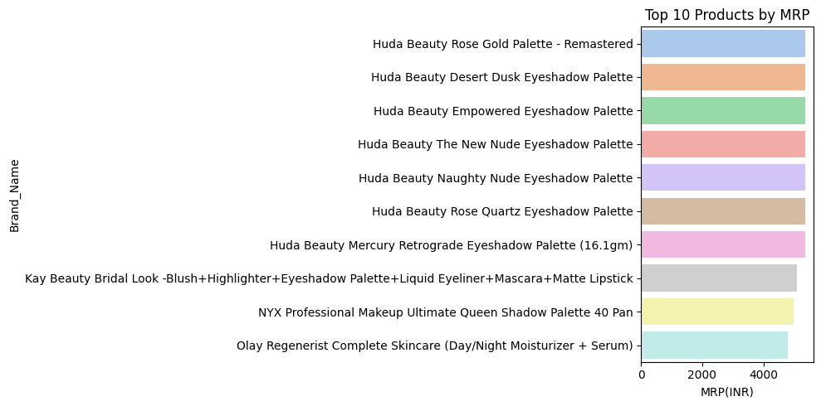
PRICING AND DISCOUNTS
What Are Nykaa’s Most Premium Offerings?
Huda Beauty dominates the premium price tier, occupying 7 of the top 10 most expensive product slots, primarily with various Eyeshadow Palettes.
The top 10 most expensive products are highly concentrated in the makeup category, featuring eyeshadow palettes, multi-item kits (Kay Beauty, NYX), and one skincare set (Olay Regenerist).
Prices for the top 10 products are tightly clustered near the 5,000 INR maximum.

Slide 8
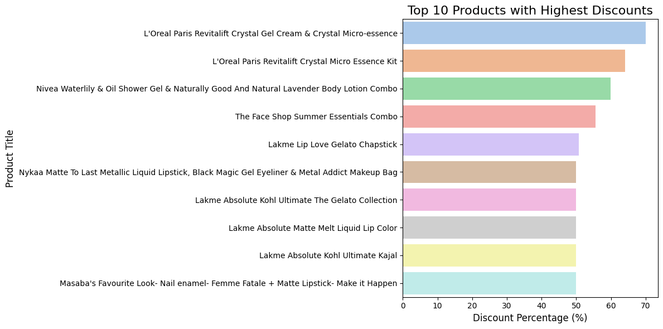
PRICING AND DISCOUNTS
Which Products Depend Heavily on Discounts to Sell?
The two highest discounts (around 70%) are applied to multi-product kits from L'Oreal Paris, indicating a strategy to move volume through bundled offers.
The majority of the top 10 discounts, including products from Nivea, The Face Shop, and Lakme, cluster tightly between 50% and 60%.
The highest discounts are spread across diverse categories, including skincare kits (L'Oreal Paris, Nivea, The Face Shop) and makeup combos (Lakme, Nykaa), suggesting broad promotional activity.

Slide 9
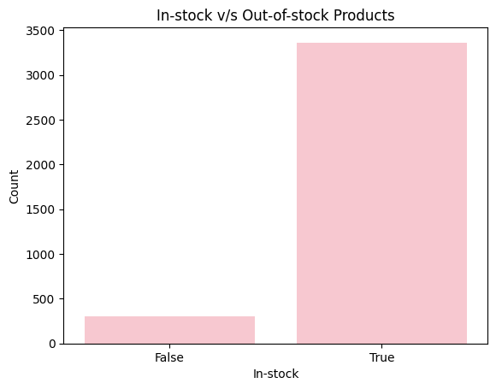
STOCK AVAILABILITY
Is Nykaa Missing Sales Opportunities Due to Stockouts?
The heavy promotion and high discount rates on popular multi-product kits risk rapid depletion of inventory, meaning the company must be vigilant about potential stockouts and the resultant missed sales.

Slide 10
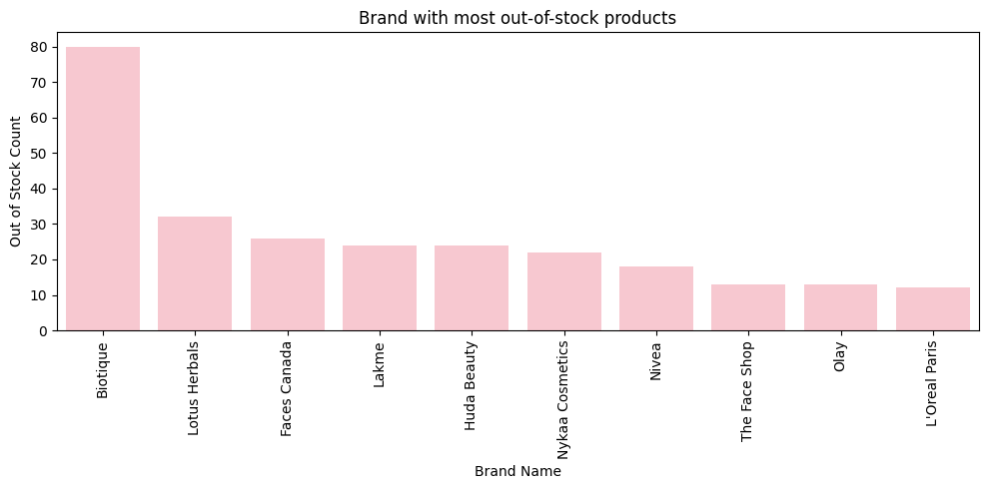
STOCK AVAILABILITY
Which Brands Struggle Most with Stock Availability?
Biotique faces a critical inventory management challenge, accounting for the highest volume of stockouts far surpassing all other brands.
Other prominent brands like Mamaearth, The Body Shop, and SUGAR Cosmetics also report considerable stockout issues

Slide 11
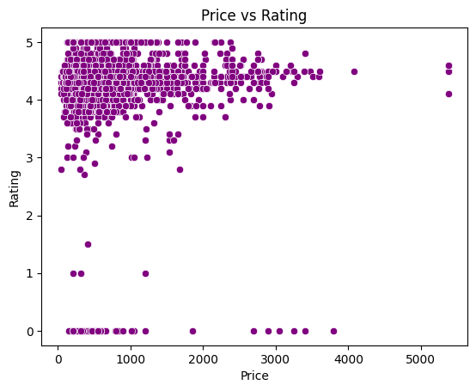
PRICE & RATING
Do Higher Prices Guarantee Better Ratings?
Products priced above INR 4000 consistently achieve the highest customer satisfaction (average ratings of 4.5 and above), validating the quality and value proposition in the high-end segment.
.
The majority of products regardless of price, maintain a strong average rating (most products ≥4.0), indicating a reliable, high baseline of quality that is well-received by customers.

Slide 12
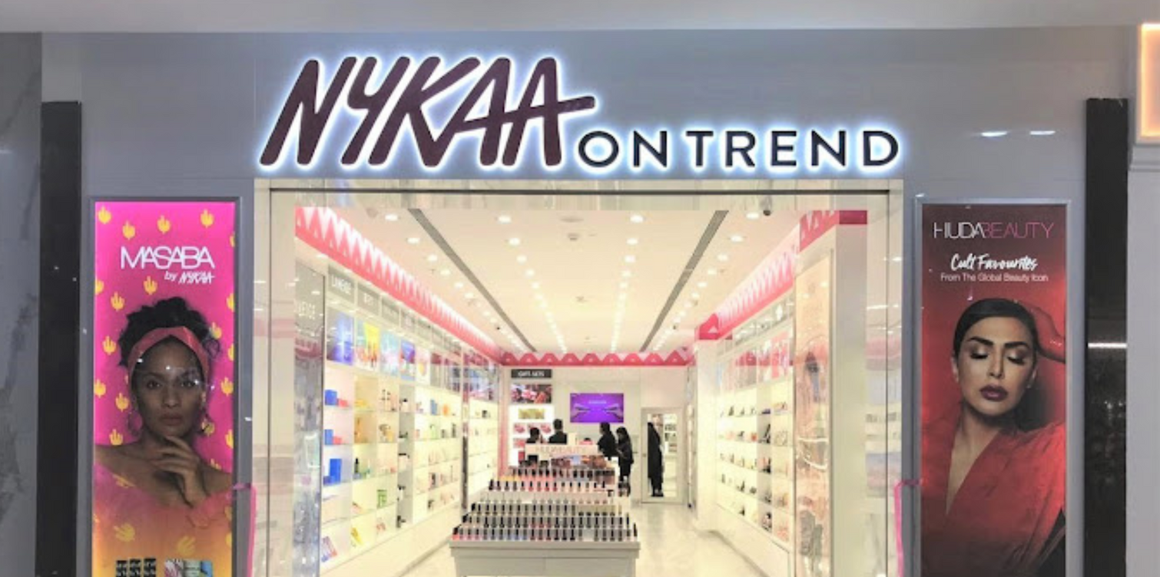
STRATEGIC INSIGHTS FOR NYKAA’S GROWTH
Nykaa-owned brands (1,253 products) dominate the catalog, 2.5x bigger than Biotique.
Focused promotions here can directly boost high-margin sales.
Top external brands: Biotique (370), Lakme (242), Colorbar (230), Lotus Herbals (215), Faces Canada (197) Exclusive partnerships can strengthen customer loyalty and sales share
7+ brands with <5 products each (e.g., Kayali, Moi, Veet, Aveeno).Either expand Stock Keeping Units (SKUs) for niche demand or phase out to declutter.
If 10% of top 3 brands (Nykaa, Nykaa Naturals, Biotique) go out of stock → ~160 products unavailable.
Assuming avg. price = ₹500 → ₹80,00,000+ lost sales opportunity. Predictive inventory planning can prevent major revenue leakage
Premium brands (Huda Beauty – 103, L’Oreal Paris – 192, Maybelline – 164) thrive on discounts.
Use flash sales to attract customers, then cross-sell Nykaa’s in-house brands.

Slide 13
Presented by:Ayesha Nadaf
Thank You!

